Slide 1


AIBridge
Lecture 2
Notes:
Welcome, (intro abt urself), I will be teaching lecture 2 today, which will be about 3 forms machine learning: supervised, unsupervised, and reinforcement learning, and some specifics about supervised learning, we will talk about generative AI in the next day. If the last sentence didn’t really make sense, do not worry, as I will elaborate more on it. (QUESTION) How many people have previously learned about ai or ml models? So, this is probably everyone's first time learning about the different ai and ml models, so what is a ml model?

Slide 2
Term Definitions
Artificial Intelligence
Human Intelligence In General
Machine Learning
Mainstream AI
“Model”
AI/ML in use
Notes:
Well overall AI is not magic, nor is it an actual simulated human doing the work. It is just a combination of a bunch of algorithms and mathematical equations, condensed and run to get outputs. It is a way to solve problems that could only be completed by human intelligence, and they way we do this is by mimicking human intelligence using various algorithms and other systems. Machine learning on the other hand is a subset of AI and is now the mainstream way to solve all AI related problems. Machine learning is based on the concepts of having a machine learn over time by changing the equations they work off slightly until the best results are reached. For the purposes of this lecture, we will be using the terms Artificial Intelligence and Machine learning interchangeably. On a side not you can research something called expert systems if you want to learn more about AI that isn’t machine learning. Another term we will be using during this lecture is “model”, and models are basically the machine learning forms but in actual usage. Models also learn based off the idea that there will be a pattern, meaning that models are always wrong, but just find the easiest and simplest pattern they can. (QUESTION) So why do you think that is significant, does anyone have any guesses? (ANSWER) Well one of the main implications of this is that we can more easily generalize the models, but also that means we must test multiple different models to find which one works the best for our purposes.

Slide 3
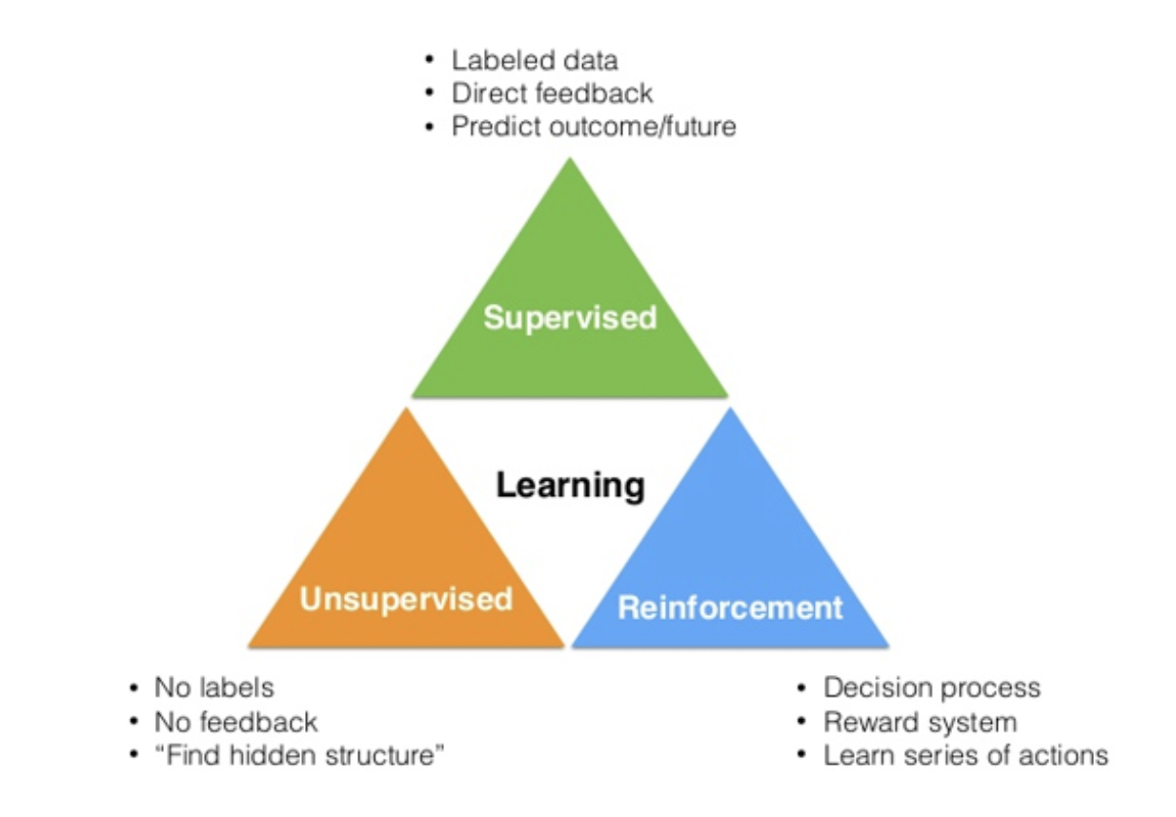
Machine Learning
Notes:
So, what are the three forms of machine learning? Well, here is a diagram of all the three forms. You don’t need to note this, as we will explain them in more detail soon.

Slide 4
SUPERVISED LEARNING
Notes:
The first model we will be talking about is supervised learning, the most common form of machine learning.

Slide 5
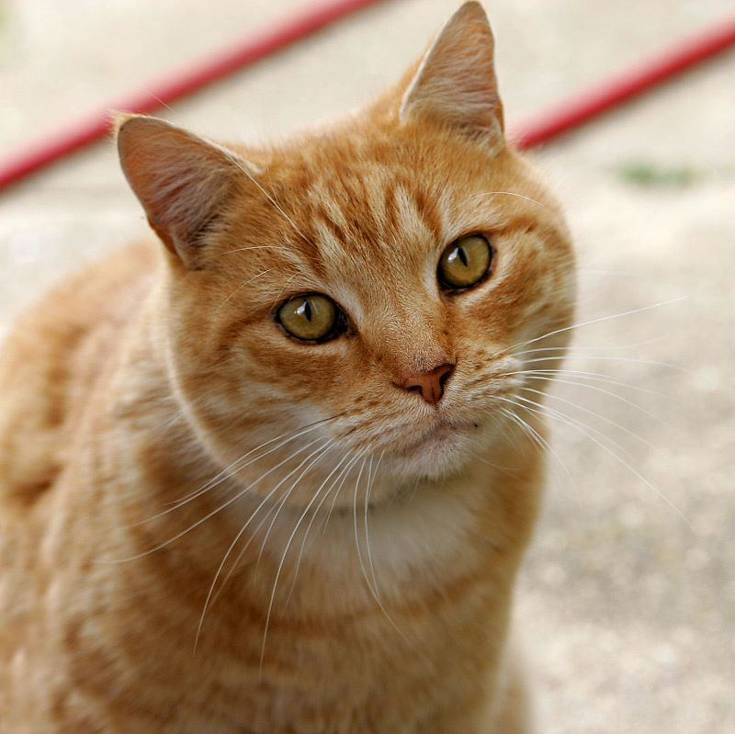




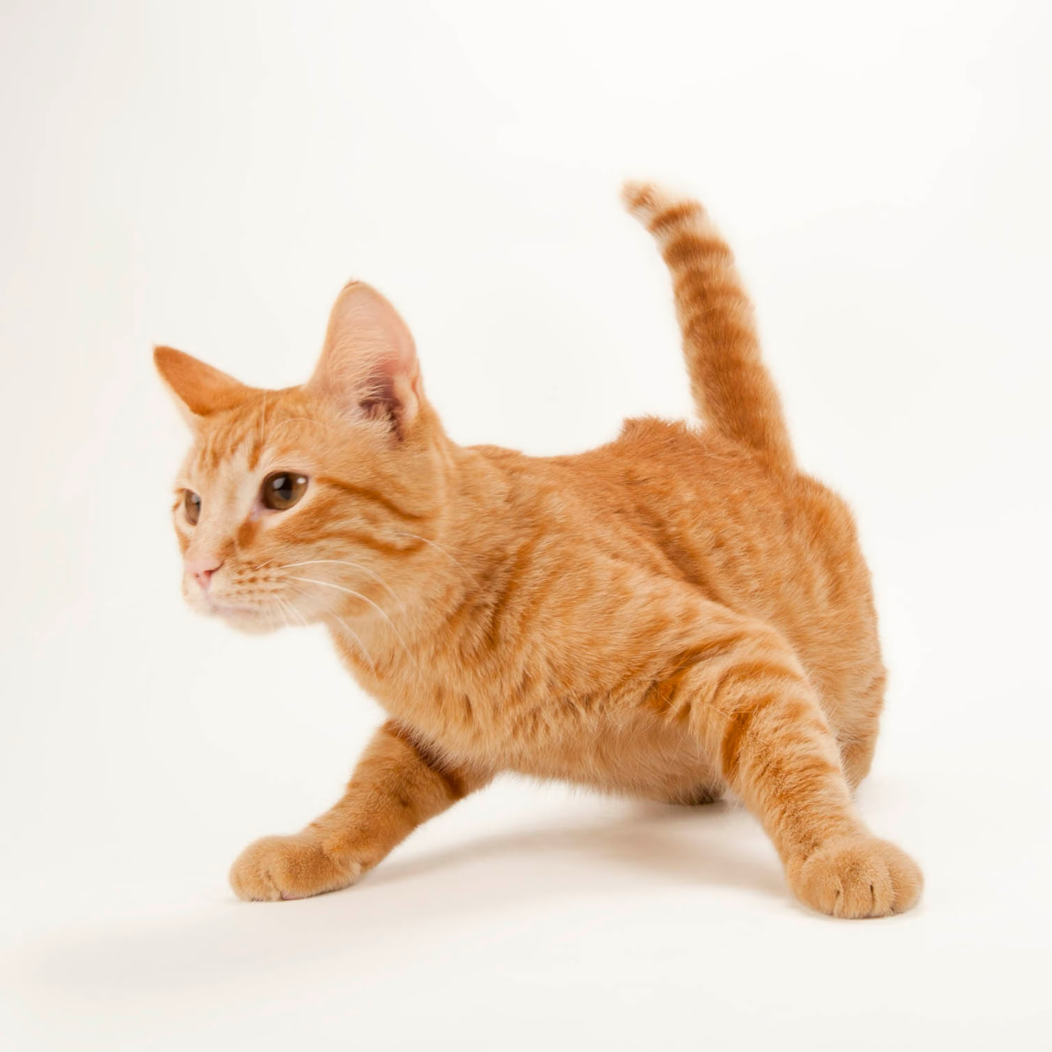
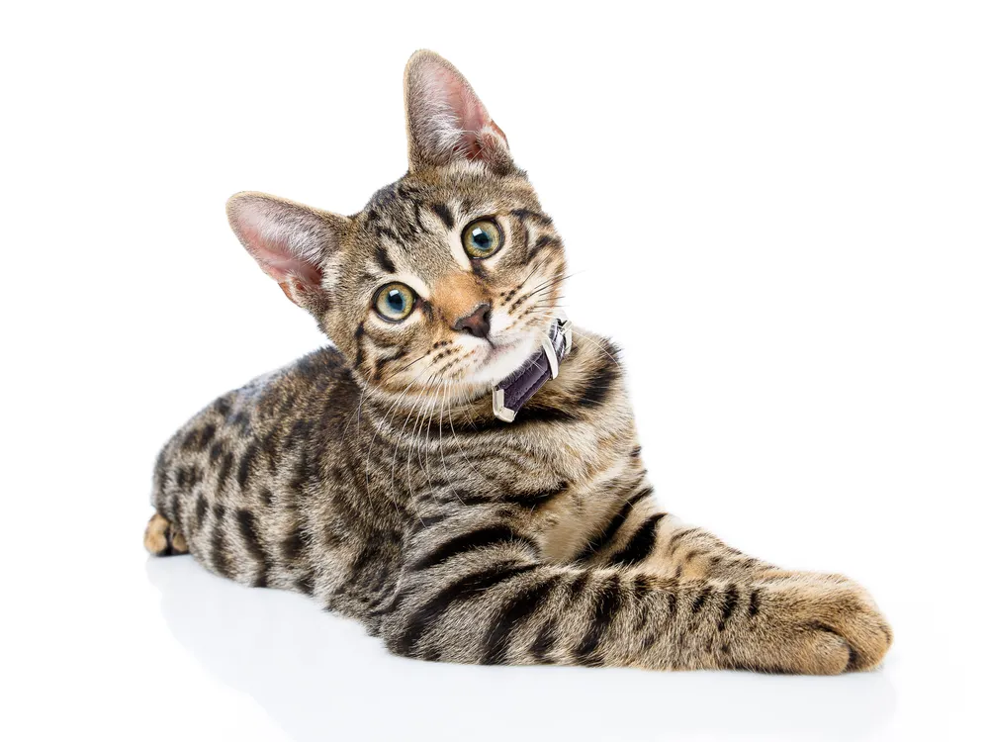
Supervised learning
Training the model with labeled data
Most widely used ML techniques in real world applications.
Cat
Cat
Notes:
Supervised learning can be differentiated from other forms of machine learning as the data inputted is labeled specifically, such as giving a pictures of cats to the computer and training it to later return cat when it's given a picture of a cat. Common forms of supervised learning include recognition, such as image or audio recognition, but also for predicting things. Later in the lecture we will be diving into the specifics of 2 forms of supervised learning, these being…

Slide 6
Supervised Learning
Classification:
Predicting a label/class/category
Ex: spam or not, cancer or not, cat or dog, red wine vs. white wine
Regression:
Predicting a (continuous) quantity
Ex: Survival rate, wine quality, yield prediction
Notes:
Classification: predict a “class” (hence classification), such as different types of flowers or colors of wine, specific # of outputs
Regression: Continuous, picture a line, with an input and output, infinite inputs and infinite outputs

Slide 7
UNSUPERVISED LEARNING
Notes:
Next, we will be talking about unsupervised learning, and it is called unsupervised because it is the opposite of supervised. In this case, the model... (lead in to next slide)

Slide 8
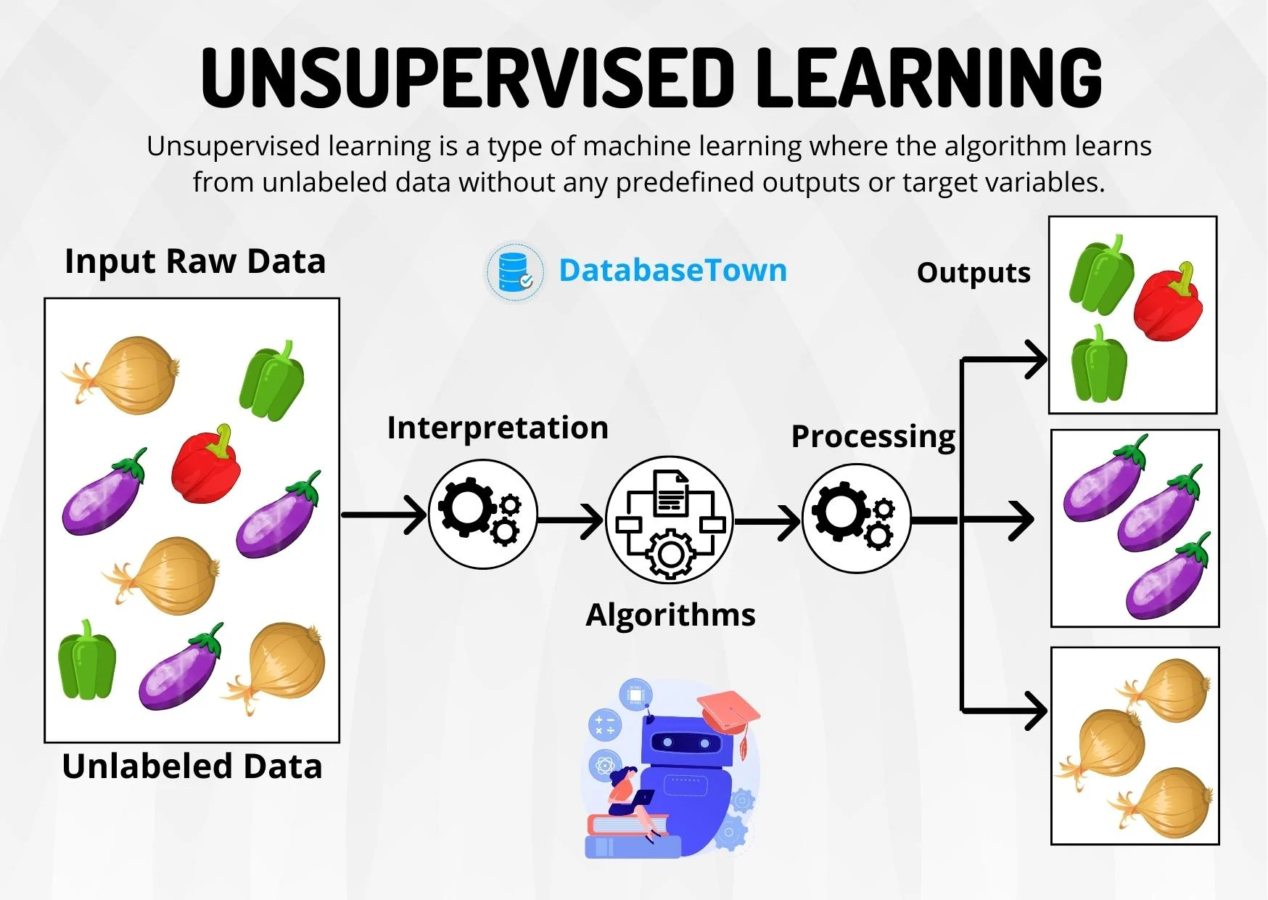
Unsupervised Learning
Notes:
(From past slide) is a form of machine learning where the data given to the model is unlabeled. The reason we have unlabeled data is because actual labeled data is not only expensive but it also takes a lot of time to go through and label every datapoint. Most datasets have tens of thousands or maybe even millions of datapoints or images, so it would take a very very long time to go through and label all of them. As we can see in the image, the model seems to be grouping the different types of data, this is the basic essence of unsupervised learning, learning without labels so we cluster! So how does the model cluster(?), well the model is clustering based on what it thinks should be a cluster (in this case it is based on shape). For another example of how it learns, imagine you are a… (lead in to the next slide)

Slide 9
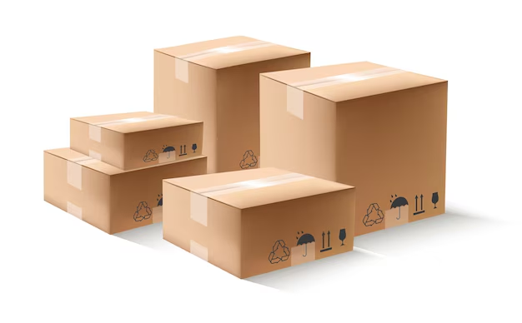

Unsupervised Learning
Notes:
(lead in from last slide)… librarian who just received a shipment of books.
(QUESTION) How would you order the books?
(ANSWER) Well although there are many ways we can order the books, such as by author name or by title alphabetically, lets say we don’t know these fancy techniques, so we could… (lead in to next slide)

Slide 10
Unsupervised Learning
Science
Novels
History
Notes:
(lead in from last slide) order the books by subject. For instance, we could have a group for each genre or subject. If we think about it, you were never given explicit instructions on how to order them or what to do, you just got the books and saw categories you could create from the books. Unsupervised learning is basically the same thing, you give the model some data, and it starts grouping without any instructions or labels. Before we move on, as a side not, remember that because the model doesn’t have labels, it groups, but it cannot generate labels for these groups either, and normally they are stored as 0, 1, 2 … for the different groups, and if you run the same model, group 0 could be a different category.
Now lets talk about the last type of learning… (lead in to next slide)

Slide 11
REINFORCEMENT LEARNING
Notes:
(lead in from last slide) reinforcement learning! Reinforcement learning can be thought of as… (lead in to next slide)

Slide 12

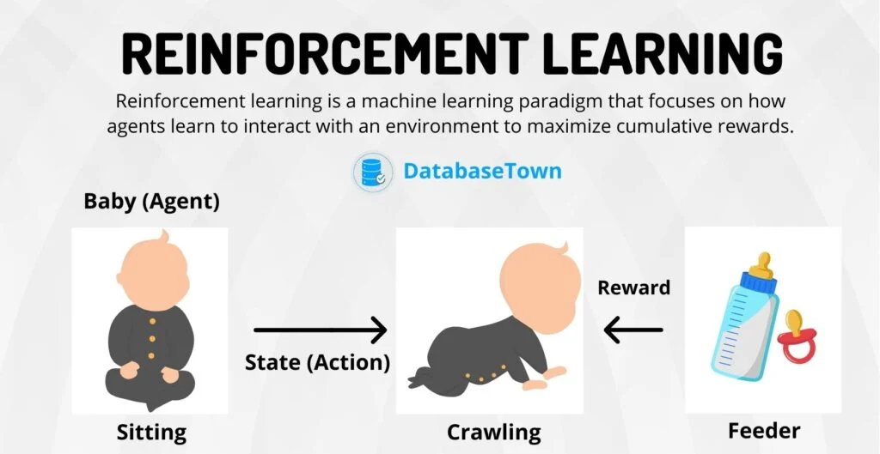
Reinforcement Learning
Notes:
(lead in from last slide) training a pet or raising a kid. The basic principle behind it is to give the model (known as the agent) a reward or punishment whenever it does something, and the model will learn by trying to maximize the reward it can attain from you. An example more easily understood is training for things such as automated robots or for models to play games. For another example of how it learns, picture a dog (click as you say this)

Slide 13

Reinforcement Learning
Notes:
The dog has 3 main actions it can take… (lead in to next slide)

Slide 14



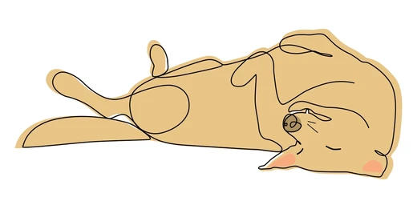

Reinforcement Learning
Notes:
(lead in from last slide) this being running, sitting, or laying down. Now to get the dog to do something, we can say that (CLICK HERE) you and the tennis ball cause an action for the dog.

Slide 15

Reinforcement Learning
Notes:
you and the tennis ball cause an action for the dog. So lets say you throw the ball (CLICK)

Slide 16
Reinforcement Learning
Notes:
What are the possible actions the dog can take? Well it can (CLICK)

Slide 17

Reinforcement Learning
NO!
NO!
Notes:
Run after the ball, lay down, or just stare at you confused.
(QUESTION) What would we do to get the dog to want to chase after the ball more?
(ANSWER) Well we want to reward it (click)

Slide 18
Reinforcement Learning
NO!
NO!
Notes:
As we reward the dog when it runs, we also want to punish the dog that laid down or sat there. Obviously as we don’t want to domestically abuse the dog, we just say no to the dog, or just down give it treats. Now over time, because the dog wants to maximize the reward it can get, getting more treats, it will slowly learn to… (lead in to next slide)

Slide 19
Reinforcement Learning
NO!
Notes:
(lead in from last slide ) Chase after the ball more, and eventually the dog will…(lead in to next slide)

Slide 20
Reinforcement Learning
Notes:
(Lead in from last slide) always chase after the ball. Now that we have discussed three, not all, but three forms of machine learning, we will now go into 2 forms of supervised learning (click, lead in)

Slide 21
Machine Learning
Notes:
So as an overview of machine learning in general, we have this diagram, that shows the three forms we talked about and specific features about them. (QUESTION) Does anyone have any questions about this?
So, lets do an activity, I will name some examples and go through the 3 model forms, and I want people to stand up if they think that the model is correct.
(QUESTION) What if we want to teach a model how to determine the type of flower based on labeled data? (ANSWER) Well this would have to be supervised, as the main giveaway is that its labeled
(QUESTION) What if we want a model to learn how to group different types wines based on certain datapoints? (ANSWER) Well first notice we want to group, this leads us to figure out that it has to be supervised or unsupervised, but because we don’t specify whether we have labeled data or not, we have to assume we do not and choose unsupervised to be the answer.
(QUESTION) What if we want a model to learn to play a game where we want it to learn a pattern that a lower speed tends to correlate lower points and higher speed tends to correlates with higher points? (ANSWER) Although because the trend seems to be linearish, lower to lower and higher to higher, we never specified the controls of the game or anything about that, so maybe the way to gain speed is not possible to do with game presses, and it would be much easier for a reinforcement learning algorithm to figure out what to do to maximize reward.

Slide 22
Supervised Learning
Classification:
Predicting a label/class/category
Ex: spam or not, cancer or not, cat or dog, red wine vs. white wine
Regression:
Predicting a (continuous) quantity
Ex: Survival rate, wine quality, yield prediction
Notes:
(lead in from last slide) as it is one of the most common machine learning algorithms used. (ASK FOR QUESTIONS ABOUT PREVIOUS 3 ALGO’S HERE) (AFTER) So supervised learning is based on input output, and we still start off by talked about…
Possible questions and answers:
How many main types of machine learning are there : 4, supervised, semi-supervised, unsupervised, reinforcement
How does a machine learning model learn : say not enough time for this, but basically there are ways we can tell the model how wrong it is (cost function, don’t need to say explicitly), and the model also has ways to adjust itself to get better over time.
What can you do with unsupervised learning- : clustering is one of the things you can do, we will explain k means in future lessons
-and reinforcement learning : image processing and video game players are some examples people might be more familiar with.
How can we train these models : we will get into the coding and specifics at the end of the lecture
What is the difference between regression and classification : you will see soon :o

Slide 23
Linear Regression
STATISTICS!
Quality
Acidity
this model could be a function
Notes:
So first we will talk about regression, and in this case we will explain linear regression. In this case, our goal is to find quality from acidity. So what is linear regression? Well, if we look at these points, you probably can roughly estimate a line of best fit (click) that goes through these points. So, we can think of linear regression as drawing the line of best fit through the given set of data points. In this example on our x axis, the horizontal, we have acidity, and on the y axis, the vertical one, we have quality. What our line tells us, is that given an acidity, we can roughly estimate the quality by finding where the point would land, or going straight up from the x position to the point it intersects with the line.

Slide 24
Linear Regression
STATISTICS!
Quality
Acidity
Notes:
So lets look at our data points again, what defines a good line? Well, (click) if we see in this example, the red line goes in the opposite direction that the trend seems to move in. (QUESTION) Can we all agree this line is bad for the data?

Slide 25
Linear Regression
STATISTICS!
Quality
Acidity
Notes:
What about this line, it seems to be a little closer, but the yellow line goes in a lightly lower direction then that of the trend. (QUESTION) Can we all agree this line is better for the data, but not perfect?

Slide 26


Linear Regression
STATISTICS!
“slope” (rotation of the line)
Quality
“intercept” (shift of the line)
Acidity
Notes:
What about this line, it seems to be a very close to the trend right? Now lets get a little refresher on how lines work,(click twice) the slope is the (click) rotation of the line, and the intercept (click) is how much we move the line up (or down if its negative)
.

Slide 27
Linear Regression
STATISTICS!
Quality
Acidity
Notes:
So earlier I asked if we could agree if the line was good or not, and how well it fit the trend right? But in this case, the computer doesn’t have an audience of smart people to tell it how good its line is, so how do you guys think the we can tell a computer how good a model is? (QUESTION) Any ideas? Well we can do something called finding error (click)

Slide 28
Linear Regression
STATISTICS!
Quality
Acidity
Notes:
And we can do this by drawing a line from the point directly to the line. Error is how we evaluate the model, we want to lower the “cost” of the model, which is a topic you can google if you want (click).

Slide 29

Linear Regression
STATISTICS!
Quality
error
Acidity
error is a measure of the “incorrectness” of a line
Notes:
So with these lines we can find how bad the line is, and if we (click)

Slide 30
Linear Regression
STATISTICS!
Quality
Acidity
Notes:
Make the line fit the data less, you can see that the lines get longer, and we get more error when we add up all of the lines. Now what if we want the model to know that being far away from a point is very bad, we can do this by (click)

Slide 31
Linear Regression
STATISTICS!
Quality
Acidity
Notes:
Squaring the different lines we have. The reason that this works, is because as we can see when we add up all of the squares (click)

Slide 32
Linear Regression
STATISTICS!
Quality
squared error
Acidity
sum-of-squared error is a common error metric for linear regression
Notes:
The points further away greatly increase the error we get, and the smaller distances barely increase in how much error they add. We call this error (click) Sum of Square Error, which is as the name suggests, the sum of the squared values of the error. So I know that that was a lot to take in at once, so (click)

Slide 33
Logistic Regression
Linear Regression
STATISTICS!
Quality
Acidity
Notes:
Before we move on from linear regression, does anyone have any questions about linear regression?
Possible Questions:
Is linear Regression always lines : No, as we will see later, linear regression will not only return straight lines, but they can also be curved and also be in multiple dimensions, but we wont talk about that in this course
(follow up) How does the model learn to make it curved then : When the model receives the error, it uses a complex algorithm to add to the equation, and eventually it would get more complicated and curve, a good question to google on your own time but unfortunately, we don’t have the time to cover that today.
What is the best error calculation : There is no best calculation for error, it ultimately comes down to what type of data you have and how complicated you want your line to be

Slide 34
Linear Regression
Logistic Regression
a possible solution…
Red = 0
White = 1
categorical label outputs are named “classes”
Notes:
Now, we are turning away from linear regression, to what’s called logistic regression. Although its called logistic regression, it is used for classification and not to find a line of best fit as linear regression did. Remember, classification is finding classes from the data given, and there is a finite amount of outputs, unlike linear regression. Logistic Regression is used to predict (click) classes, and for our example we will be seeing whether or not a wine sample is red or white. A solution is to turn the classes we want to find into a single 0 or 1, representing red and white wine.

Slide 35
Logistic Regression
White
Red
Acidity
Notes:
So to start things off, lets first construct our graph (click), and in this case we want to predict whether or not wine is white or red based on the acidity. Now lets add the points (click)

Slide 36
Logistic Regression
White
Red
Acidity
Notes:
Now if we were to use linear regression as we did in the past, our resulting graph would look something like this. Remember, this isn’t the actual data shown, but its just an example that we made, simplified from the actual dataset that exists. (click)

Slide 37

Logistic Regression
White
not super great
Red
Acidity
Notes:
If we use a linear regression model, that doesn’t look great. Like, if we get a sample closer to the middle (click), and it tells us 0.5, it doesn't give us much information. Also, if we

Slide 38
Logistic Regression
White
Red
Acidity
Notes:
If we get a value like 2 in this case, we don’t know what to do with it as we defined red as 0 and white as 1, so what is 2? Or if we

Slide 39
Logistic Regression
White
Red
Acidity
Notes:
Get a negative value as well. This also gives us no information, (QUESTION) so what do you think we can do to fix this?
Well, one solution is to change our line!

Slide 40
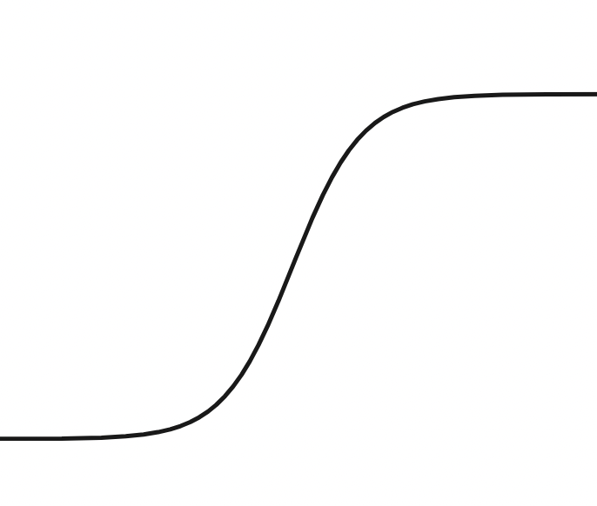
Logistic Regression
White
logistic functions!
Red
Acidity
logistic functions are a good way of making predictions on binary/categorical data
sum-of-squared error is still a common error metric for logistic regression
Notes:
So instead of drawing a straight line, we can draw a (click) curved line. This is called a logistic function. These are good for categorizing samples, as they start out flat and quickly go up in the middle, the flatten out again. We no longer have the issue of going past either class, and it even fits the data better as it goes somewhat through all of the points! But, this only works on two categories. What if we have more than one output class?

Slide 41

Logistic Regression
White
Red
Champagne
pair them up!
Notes:
For example, say we have a third class, champagne. (QUESTION) What should we do then?
(ANSWER) One solution is to pair them up. (click)

Slide 42
Logistic Regression
White
White
Red
Red
Champagne
Champagne
Notes:
We make it so we have every possible combination of the categories, in this case its these three, then we use each model to find the highest probability.

Slide 43
Logistic Regression
White
White
Red
Red
Champagne
Champagne
Notes:
In this example, the first model says the wine is white, and the next one says the wine is

Slide 44
Logistic Regression
White
White
Red
Red
Champagne
Champagne
Notes:
Also white! The last model says the wine is most likely

Slide 45
Logistic Regression
White
White
Red
Red
Champagne
Champagne
Notes:
Champagne in this case. So we have a vote for white, white, and champagne, and we pick whichever one the most say.

Slide 46


Logistic Regression
more pairs
voted for white!
White
White
Red
Red
Champagne
Champagne
Its White!
One-vs-one multiclass classification uses the most “voted for” class among paired models
Notes:
(click click) So we see that the most votes went towards white! (click) So we conclude its white! (click) this is called one vs one classification, as you pair up each class one to one. (QUESTIONS) Does anyone have any questions? For a better visual, we can look back at our logistic function graph (click)

Slide 47
Logistic Regression
White
Red
Acidity
Notes:
Imagine taking 3 of these graphs, with the different classes on the top and bottom, and the compiling all the results! What if we have 50 classes however, that would be 1225 pairs of separate models we would have to run through. Out of those 1225 only 50 would contain the correct class (if it was red only 50 models have red in the pair), so what we can do instead is compare 1 to the 49, and see which model returns the highest probability. To better visualize this lets go back to our 3 wine example (click)

Slide 48
Logistic Regression
Put each against all
White
Red
Champagne
Not White
Not Red
Not Champagne
Notes:
This time we pair each class to the classes that are not it (click), and we can then run much fewer models.

Slide 49
Logistic Regression
See which has the highest Probability
White
Red
Champagne
Not White
Not Red
Not Champagne
Its White!
One-vs-all multiclass classification uses the highest probability class among labeled models
Notes:
So, if we run through all of the models again, we first see (click) which set has the highest probability and let's say the model on white data returned .8, and the red and champagne each returned like .1 and .2 respectively. We can see that it doesn’t add up to 100, this is because the models are independent, but we select the highest probability which would be (click) white in this case. This form of classification is called (click) one vs all and is used when there are more classes, and it would not be feasible to use one vs one classification.

Slide 50
Logistic Regression
White
Not White
Acidity
Notes:
This is a visualization of what it could look like. In this case red and champagne are very similar so it would be much easier to distinguish white from them, but in truth the model could have the white in the middle, it doesn’t matter, as long as the logistic function is able to only be white when it is truly near white. (QUESTION) Does anyone have any questions? (AFTER) So now that we know 2 forms of supervised learning, we will talk about overfitting, so what is overfitting?
Possible Questions:
When is it better to use ovo and ova : ovo is better when there are fewer classes or in more complex models, where distinctions between pairs is important, ova is better for large number of classes, need for more efficiency, as well as class imbalance and simpler models.
Are all logistic functions that weird ‘s’ shape : Yes, but different models will have steeper or less steep, and shifted left and right graphs, that are all determined when the model learns the data set

Slide 51
overfitting
Quality
Which one is a better line?
Acidity
Notes:
Well lets go back to our original graph, we can once again draw out line of best fit (click). This line is pretty good right, but lets consider another line (click) that goes through all of the data points. So we have these 2 lines, (click) so which ones the better one? (QUESTION) What do you think?

Slide 52
overfitting
Quality
Acidity
this model has more predictive power
Notes:
How about this green line, the green line has more predictive power (click), what this means is that if we use a random data point that the model didn’t see (click) which is this yellow point, we can see that it is (click) very close and has little error.

Slide 53
overfitting
Quality
Acidity
this model is highly accurate on training data
but bad at predictions anywhere else
Notes:
Now lets discuss the red line, the red line has much less predictive power (click), what this means is that if we use the same data point as the last slide that the model didn’t see (click), we can see that it is (click) very far and has a lot of error. This line is very accurate for the training data, which is the black points (click) but is bad at predictions.

Slide 54

overfitting
Quality
overfit!
Acidity
too-precise fits to original data without generalization is called overfitting
Notes:
This is what we call overfitting, as the red line is no longer good for predicting, which is what we want the model to do. (QUESTION) Does anyone have any questions?

Slide 55
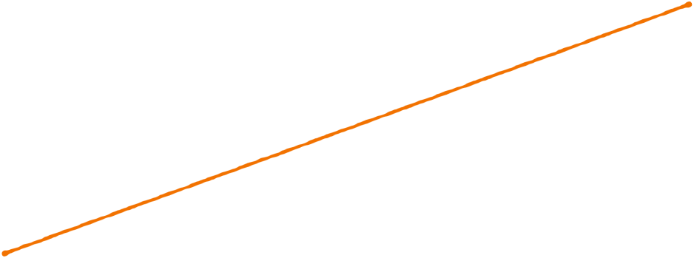

overfitting
degree 1
underfit!
model is unable to capture relationship between variables
Notes:
Now we have a new set of data points, if we draw a line (click) that goes through these points, would this be a good representation of the data? Well first off this is a line of degree 1 (click), and as you can probably tell, it doesn’t represent the data, (QUESTION) How do you think the line should look? (ANSWER) Well it should be like an upside down U right? So we call this underfit (click), as it doesn’t represent the data enough (click). So how about we look at a different line (lead in to next slide)

Slide 56
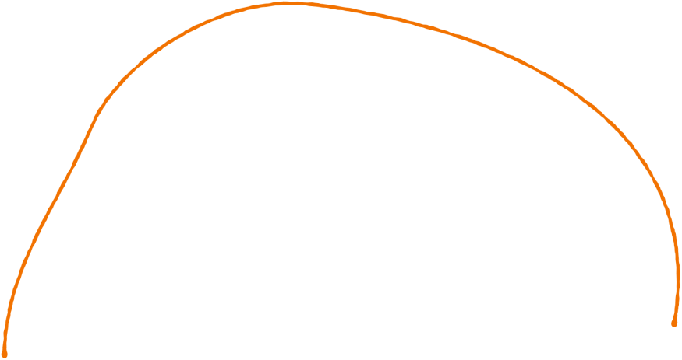
overfitting
degree 2
Notes:
(Lead in from last slide) of degree 2. We can see that this represents the data a lot better right? Now what about a line of degree… (lead in to next slide)

Slide 57
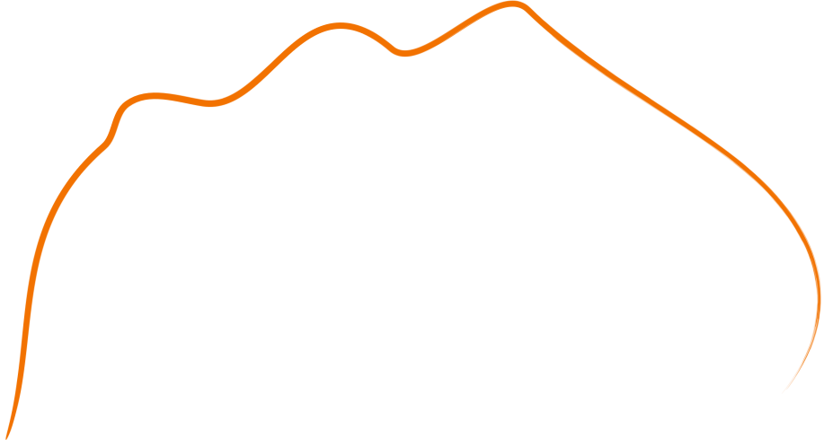
overfitting
degree 6
Notes:
(Lead in from last slide) of degree 6. We can see that this represents the data but is also starting to curve around, and what about a line of degree…

Slide 58
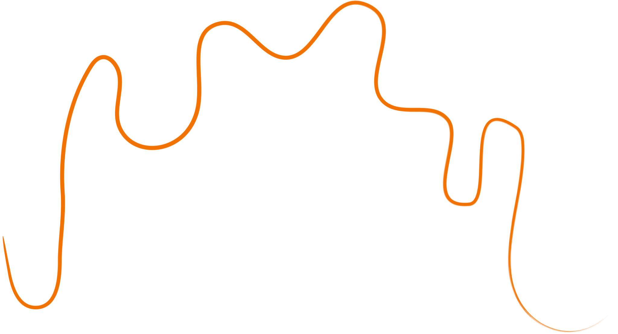
overfitting
degree 10
that’s overfit!
Notes:
(Lead in from last slide) of degree 10. We can see that this is now curving to go through all of the data points, and this is (click) overfit! So how can we tell its overfit? Well we can look at some data points the model hasn’t seen yet

Slide 59
overfitting
Notes:
You can see that it gets very far away from many points that are relatively close to other points. We can also tell its overfit because of how much its curving in such a simple graph. The sum of squared penalty shown earlier would work very well there are many large errors.

Slide 60

overfitting
still not good
Notes:
Now if we look at our first line, we can see that either way it still misses some of the training points and testing points, so it is (click) still not good.

Slide 61
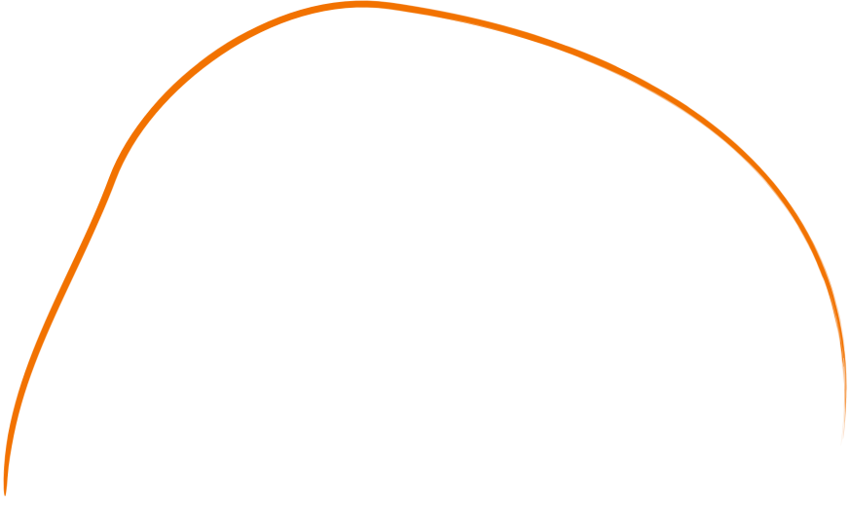
overfitting
Notes:
Now if we look at our second line, we can see that it follows the trend very well and would work best out of all of the lines shown most likely. Now we have talked a lot about overfitting, and before we get into addressing it, (QUESTION) does anyone have any questions?

Slide 62
overfitting can be dangerous
data ethics
Notes:
Ok, so why do we care about overfitting so much? Overfitting creates models that might perform really well when training but when you deploy this supposedly amazing model in the real world, it can cause real damage.

Slide 63
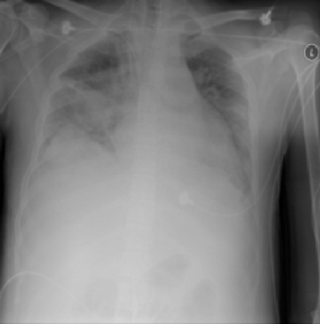
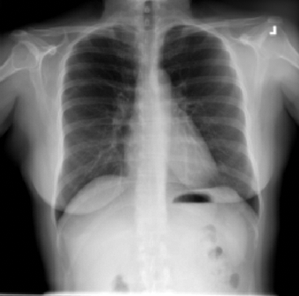
data ethics
which one has pneumonia?
Notes:
First, lets talk about a case when overfitting can be dangerous. In this example, a model was trained to detect pneumonia in patients xrays. (click) Here we have 2 x-ray images of lungs with and without pneumonia. (QUESTION) Which image do you think has pneumonia?
(ANSWER) In this case, the person on the left is the one who has pneumonia.
However, the model decided with 90% certainty that it was the person on the right. If we highlight the area that the model focused on the most, (QUESTION) So why do you think the model got it wrong? (ANSWER) well its because of overfitting!

Slide 64


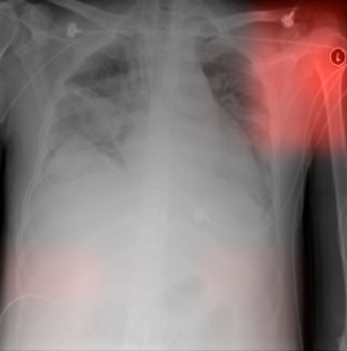
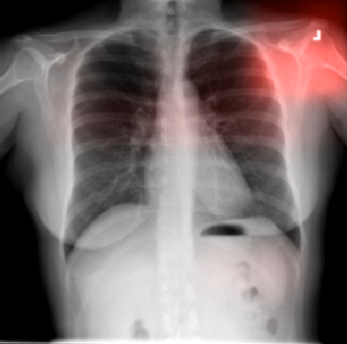
data ethics
different hospitals used different markers!
models, when not controlled for external factors, often overfit on easy targets
Notes:
It was really focused on the top right, the shoulder area. So as a bit of context, the hospital that provided the pneumonia data for this model had a specific marker that it placed on all their xrays, and the hospital that provided the non-pneumonia data used a different one. (click) Because machine learning models love finding shortcuts to answering questions and finding patterns, the model started overfitting to that one marker, because when it was training, whenever it saw that marker it would immediately mean that the patient had pneumonia. (click) When a different one showed up, it would immediately mean that the patient didn’t have pneumonia.

Slide 65
How do we under/ ?
address overfitting
Notes:
Now that we know what overfitting is and how dangerous it can be, how do we address it? Well lets first look at out dataset (next slide)

Slide 66
address overfitting
training data
Notes:
The easiest way to address overfitting is by first splitting the data (lead in to next slide)

Slide 67
address overfitting
validation data
training data
test data
Notes:
(lead in from last slide) Into three parts, most of the data being in the training data, and some in validation and test data. So

Slide 68


address overfitting
Model Hasn’t Seen
Model Has Seen
validation data
training data
test data
we use validation and test sets, small subsets of data the model hasn’t seen before,
val point(s)!
Notes:
So training data is different from validation data and test data (click) because the training data is what the model gets to see to train, but it never sees the validation or test data (click). For example, our first graph we used a validation point to see that the model was overfit (click).

Slide 69


address overfitting
Model Hasn’t Seen
Model Has Seen
validation data
training data
What’s the difference?
test data
Notes:
But what is the difference? Well, the validation data is used during training to see if the model is overfit, however the training data is (lead in to next slide)
Testing data is a small section of your whole dataset. You only deal with testing data once you are 100% done with your model. The purpose of testing data is to: (click) compare different models' performance. The test set will always be the same for the same dataset, usually, its even supplied separately to avoid confusion. (click) When you want to test multiple models’ performance on a dataset, using a common set of benchmark data ensures that any improvements in accuracy are from the model improving and not just a difference in the testing material.

Slide 70
address overfitting
Whole Dataset
standardized for benchmarking!
test data
test sets are, unlike validation sets, usually set by the data creator as common, unseen benchmark data.
Notes:
Testing data is a small section of your whole dataset. You only deal with testing data once you are 100% done with your model. The purpose of testing data is to: (click) compare different models' performance. The test set will always be the same for the same dataset, usually, its even supplied separately to avoid confusion. (click) When you want to test multiple models’ performance on a dataset, using a common set of benchmark data ensures that any improvements in accuracy are from the model improving and not just a difference in the testing material.
That is the end of Lecture 2, (QUESTION) Does anyone have any questions before the lab?

